Slide 1



Avian Influenza
Aubrianna Brown, Jake Carbone, Darian Devereaux,
Bryce Hopper, Alyvia Nazak, Kylie Perlow

Slide 2

Background
-Infectious viral disease in wild birds that has spread to domestic poultry (Authority et al. 2017)
- 2 main forms:
- Low pathogenic (LPAI): causes mild symptoms (ruffled feathers or drop in egg production)
- Highly pathogenic (HPAI): causes more severe symptoms (lack of energy and appetite, purple discoloration, diarrhea, nasal discharge, coughing, and lack of coordination) and very high mortality rates in poultry (impacts profitability of poultry) (CDC 2022)
- Mainly found in birds, but can also occur in humans (though risk is low)
- Virus can be carried by wild birds over long distances during migration which can create a large threat to wild and domestic birds
-Can be transmitted to humans, but not from human to human (Leydet. 2022)

Slide 3
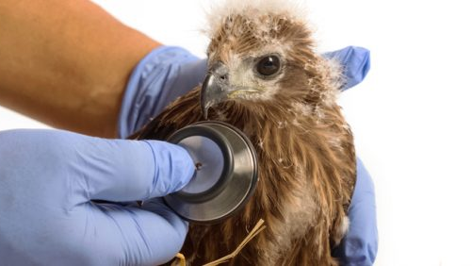
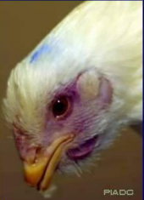
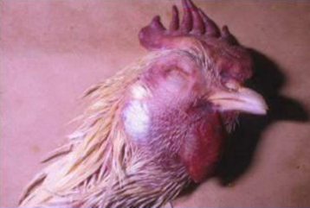
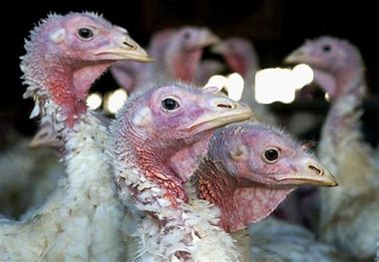
Threats
HPAI is highly lethal and LPAI is less severely symptomatic
HPAI viruses are highly neurotropic and cause neurological diseases
Infected birds experienced histological lesions
Neuraminidase prevents viral aggregation and aids movement of virus through the respiratory tract
Notes:
Caliendo, V., L. Leijten, M. W. G. van de Bildt, R. A. M. Fouchier, J. M. Rijks, and T. Kuiken. 2022. Pathology and virology of natural highly pathogenic avian influenza H5N8 infection in wild Common buzzards (Buteo buteo). Scientific Reports 12:920.
Stephenson, I., and J. Democratis. 2005. Influenza: current threat from avian influenza. British Medical Bulletin 75–76:63–80.

Slide 4
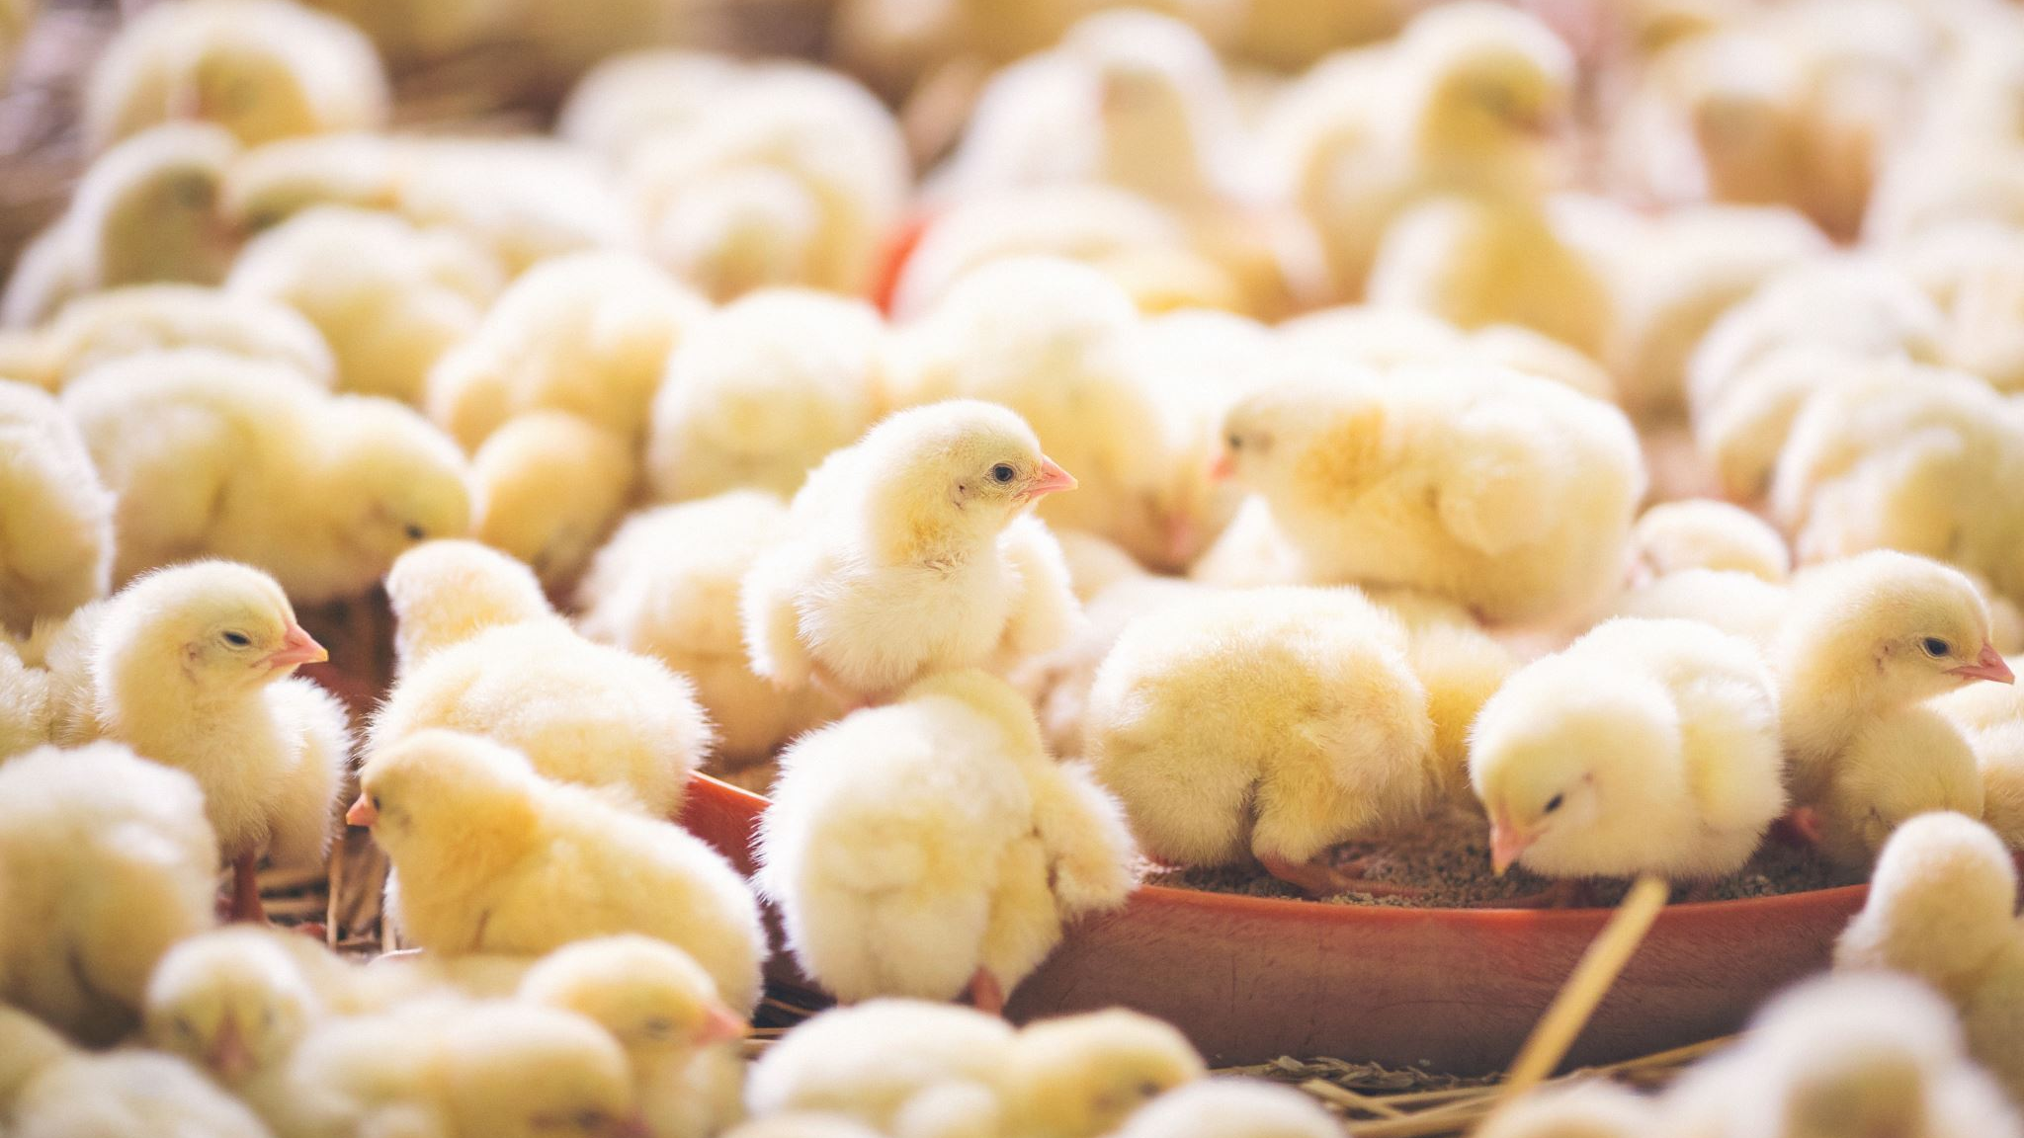
Impact on Farms and the Economy
Widespread culling of chickens on poultry farms due to outbreak
Comes from contact with infected waterfowl or surface
Due to massive numbers of birds in small spaces (typical of poultry farms) the disease spreads fast
Long-lasting impacts on farmers' livelihood
Economy takes a hit:
Turkey and chicken eggs, and meat become more expensive

Slide 5
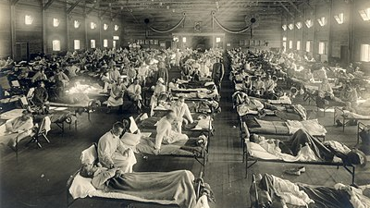
A Possible Pandemic
Avian Influenza is the most general flu
Infects a variety of birds and mammals
Constantly mutating into different strains (Lycett et al. 2019)
There have been approximately four major IAV pandemics such as The Spanish Flu (1918 est. 50 million), The Asian Flu (1957 est. 1.1 million), Swine Flu (2009 est. 575 thousand) (Lycett et al. 2019)
The flu vaccine is only about 40% effective, and only a fraction of the population receive it each year (Healthline 2021).
Dr. Leydet suggests the best method of prevention is surveillance, and for those in close contact with bird species to mask, avoid cross contamination between bird populations, and isolate infected birds (Leydet 2022).
This Photo by Unknown author is licensed under CC BY-SA.

Slide 6
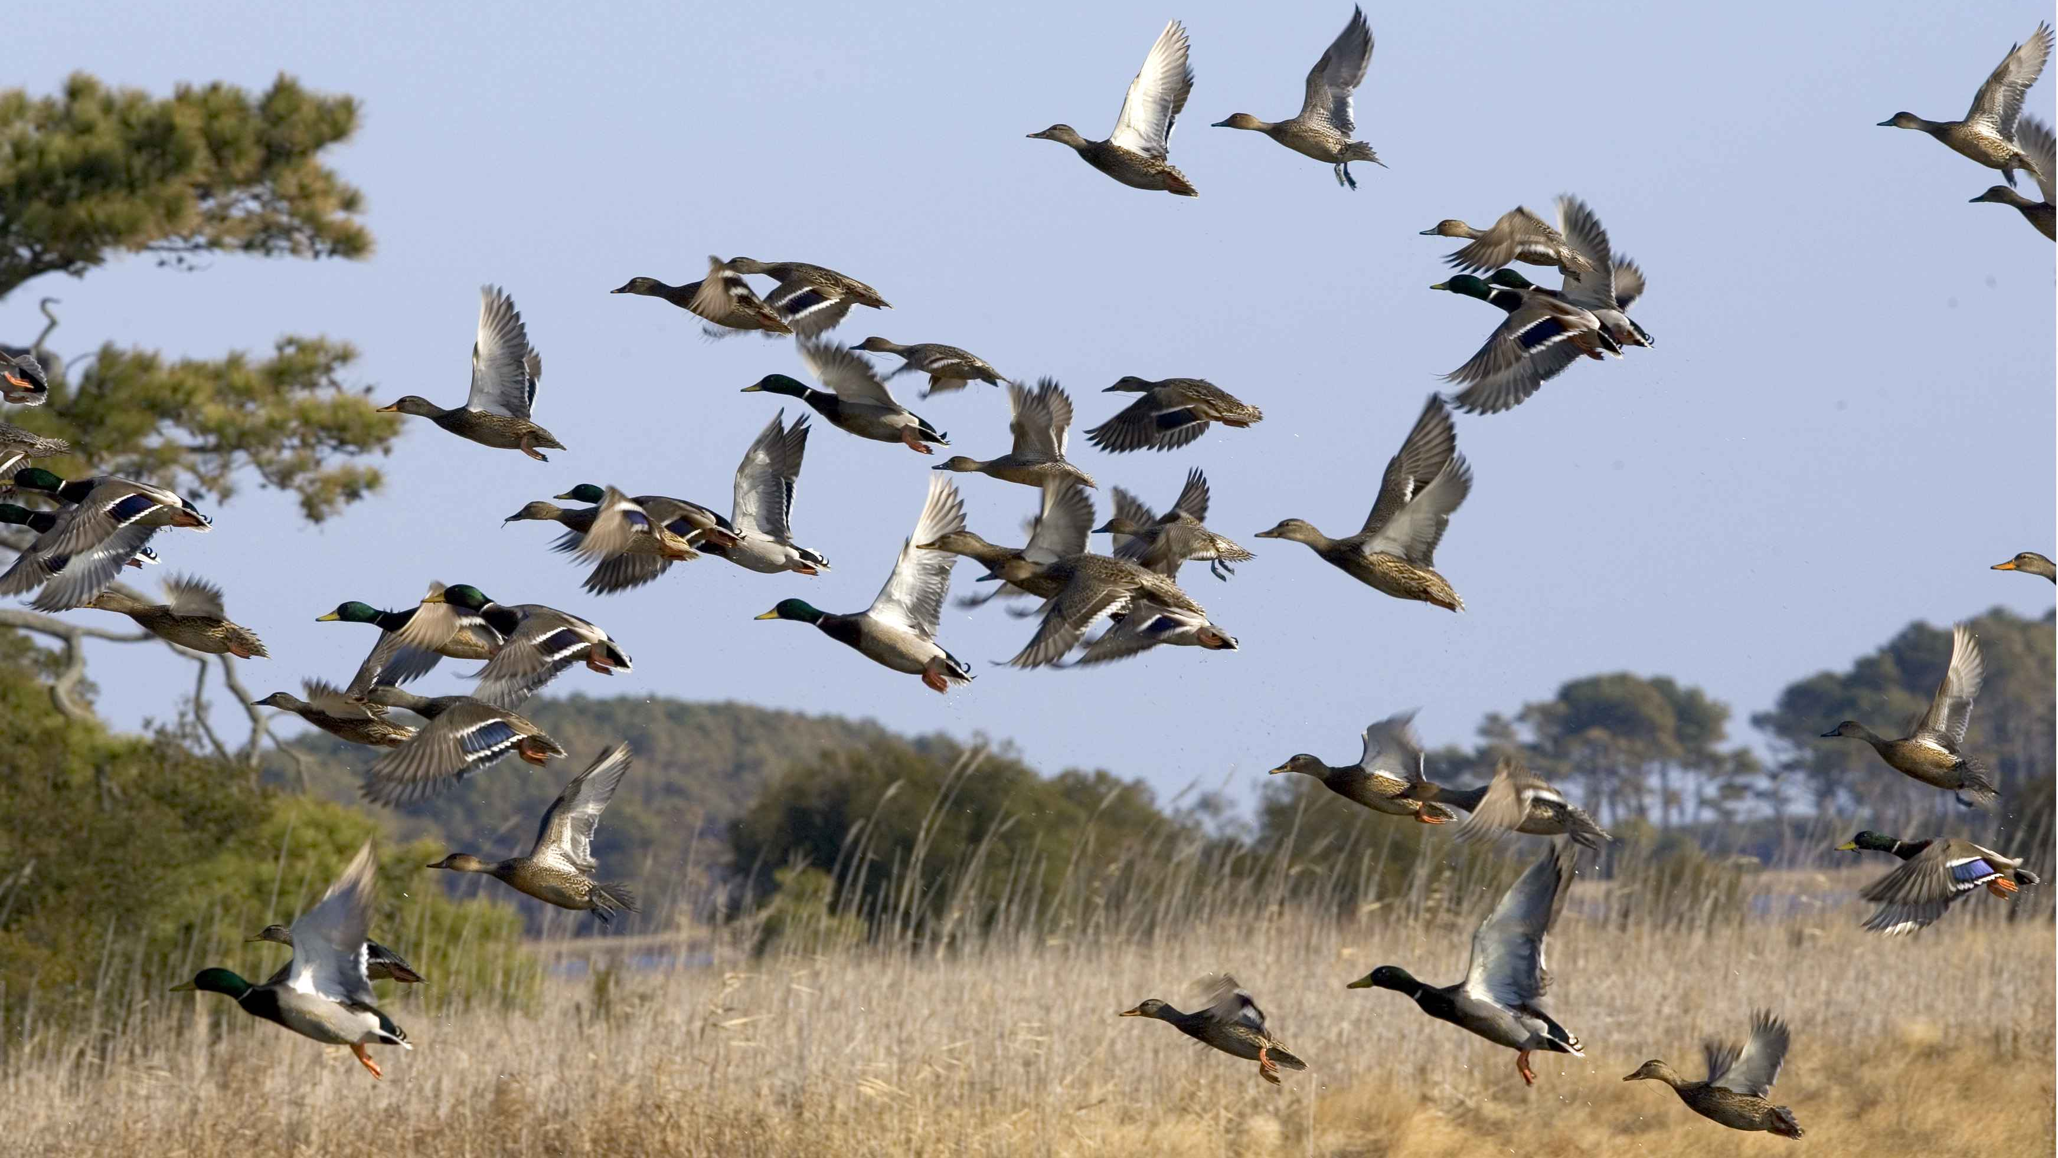
North American Model for Wildlife Conservation
Difficult to apply the NAMWC to an influenza.
Currently, surveillance of migratory birds across the country has been increased in the hopes to prevent the spread through early detection, communication, diagnoses, and when necessary, management measures based on findings.
Less concerning to wild bird species like ducks, geese, swans, etc. as it is to poultry species.
Likely huge economic impacts to agriculture/poultry farms while in the wild the mortality rate is far lower and often dormant.

Slide 7
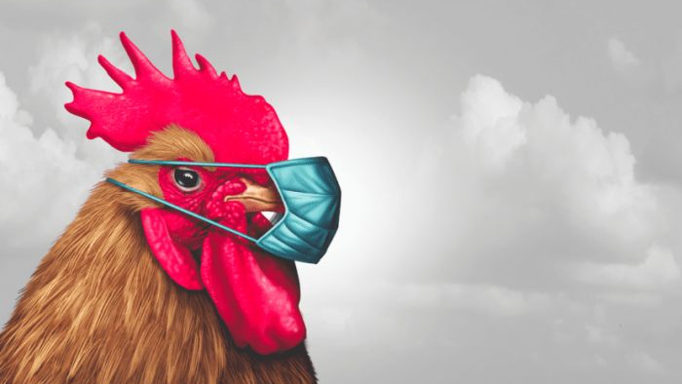
Conclusions
H5N1 is an emerging strain of highly contagious avian influenza among birds
People should be concerned because...
Led to the death of over 150 million chickens
Caused almost $10 billion in economic damage
Has a potential to be contracted by people
Avian influenza is as much of a challenge for farmers and people within agricultural sectors to take on as it is for wildlife managers
Left up to the U.S. Department of Interior and USDA APHIS to coordinate outbreak investigations and control avian influenza among animal populations and to alert the CDC when it becomes a human health concern
You can do your part by avoiding domesticated birds, practicing proper hygiene techniques, and fully cooking poultry to help reduce the spread

Slide 8
References
Authority, E. F. S., European Centre for Disease Prevention and Control, E. U. R. L. for A. Influenza, I. Brown, P. Mulatti, K. Smietanka, C. Staubach, P. Willeberg, C. Adlhoch, D. Candiani, C. Fabris, G. Zancanaro, J. Morgado, and F. Verdonck. 2017. Avian influenza overview October 2016–August 2017. EFSA Journal 15:e05018.
B. Leydet. Interviewed by Jake Carbone. November 2022.
Caliendo, V., L. Leijten, M. W. G. van de Bildt, R. A. M. Fouchier, J. M. Rijks, and T. Kuiken. 2022. Pathology and virology of natural highly pathogenic avian influenza H5N8 infection in wild Common buzzards (Buteo buteo). Scientific Reports 12:920.
CDC. 2022, March 9. Avian Influenza in Birds. https://www.cdc.gov/flu/avianflu/avian-in-birds.htm.
Healthline. 2021, February 8. Flu Vaccine Effectiveness and Duration for Adults and Children. https://www.healthline.com/health/flu-vaccine-effectiveness.
Lycett, S. J., F. Duchatel, and P. Digard. 2019. A brief history of bird flu. Philosophical Transactions of the Royal Society B 374
Stephenson, I., and J. Democratis. 2005. Influenza: current threat from avian influenza. British Medical Bulletin 75–76:63–80.
World Health Organization. (n.d.). Avian Influenza. Informational website. https://www.paho.org/en/topics/avian-influenza

